Slide 1

Analytics in Research & Development
By Juan Villegas
This Photo by Unknown Author is licensed under CC BY-SA

Slide 2
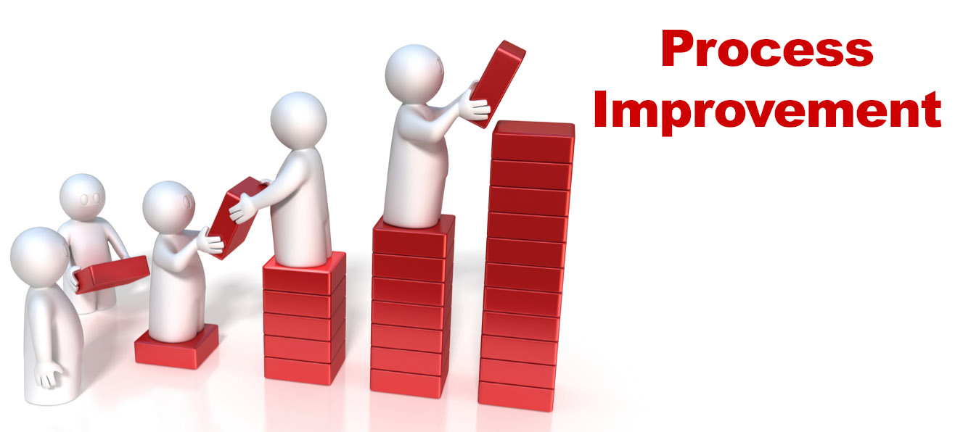
Overview
Research & Development (R&D) is work directed toward the innovation, introduction, and improvement of products and processes.
R&D can be incorporated In any industry:
Any field ( Healthcare, Business, Sports, Technology) can always improve
Every field has questions that R&D can eventually answer
This Photo by Unknown Author is licensed under CC BY-SA

Slide 3
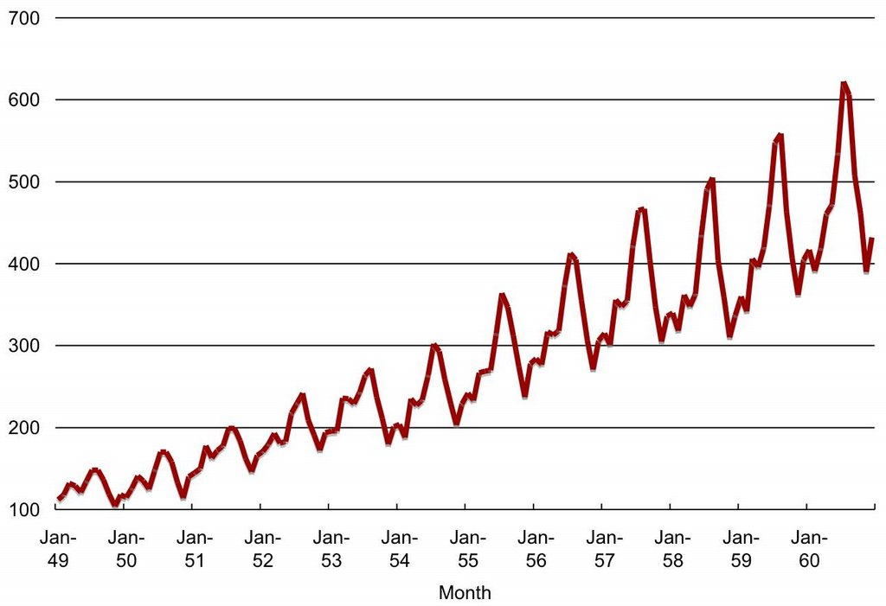
Descriptive Analytics in R&D
Descriptive Analytics: looking at (past) reported data:
Visualizations helps show what's going on in reported data
Ex: Health Care professionals use visualizations like time series charts to see if there’s changes in patients' treatment outcome.
This Photo by Unknown Author is licensed under CC BY-SA-NC

Slide 4
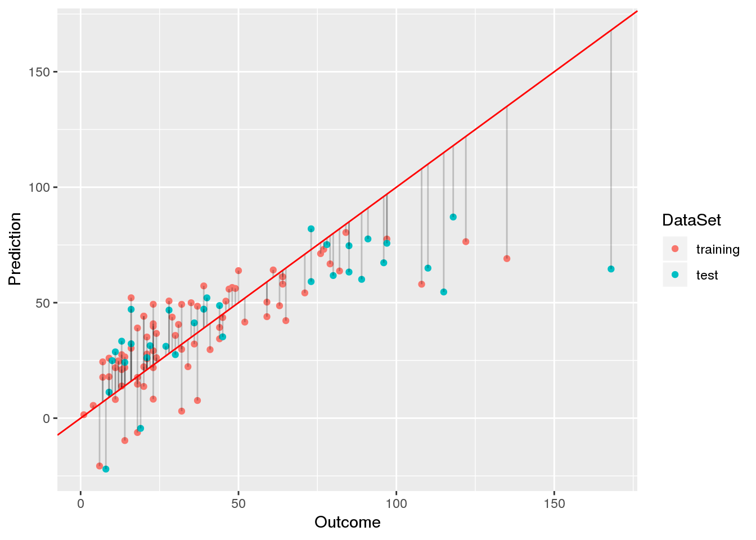
Predictive Analytics
Predictive Analytics: Using Data to make future calculations
Researchers in the sports industry use predictive analytics to help coaches make decisions.
Ex: What should we incorporate in our weekly regime?:
researchers can use multiple regression to see what has a significance in performance.
They can optimize the different attribute for a player by comparing the outputs of things using predictive models.
This Photo by Unknown Author is licensed under CC BY-SA-NC

Slide 5

Prescriptive Analytics
Prescriptive Analytics = Optimization
Optimization can easily be a task assigned to someone in R&D:
How can we optimize the number of things we sell?:
Researchers can make models that suggest customers other things to buy with products that clients look at. Amazon uses this:
“Customers frequently buy this with:”
This Photo by Unknown Author is licensed under CC BY-NC

